Slide 1
Cow disease (LSD) classification system for predicting different severity levels
By
Karthika B
Kavya S
Lokeshwaran N
Guided by
Dr. Sivamurugan V

Slide 2
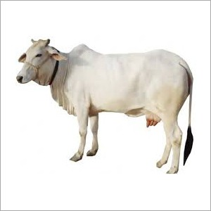
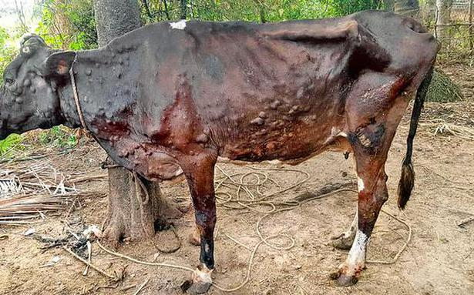
Introduction
The lumpy skin disease has created havoc in India.
The disease have already killed 75,000 cows in our country which is one of the major risk in cattle production which substantially impacts on livelihoods and food security.

Slide 3
Motivation
To assist the veterinary doctor in detecting and classifying different stages or severity levels of lumpy skin disease in cow.
To improve the milk production among cow to support the poor farmers.
To reduce mortality among cow.
To reduce the loss of cow to the farmers.
The milk from such animals may get affected due to the virus, according to reports.

Slide 4

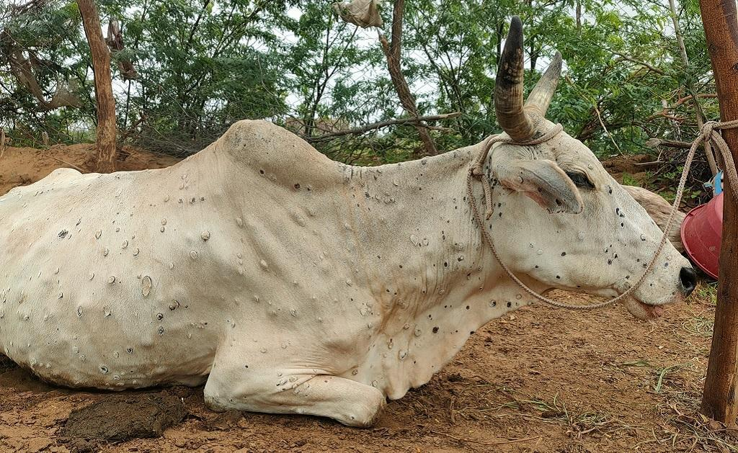

Problem Statement
To Automatically detect and classify Lumpy Skin Disease using deep learning techniques.
To develop classification models using different pre-trained deep learning models.
To compare the classification accuracy of different classification models.
To recommend a best performing model to the veterinary doctors.

Slide 5
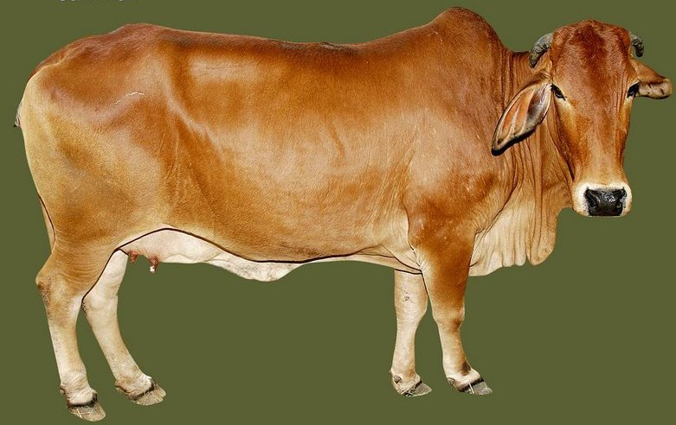
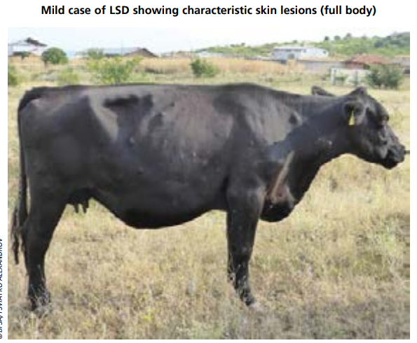
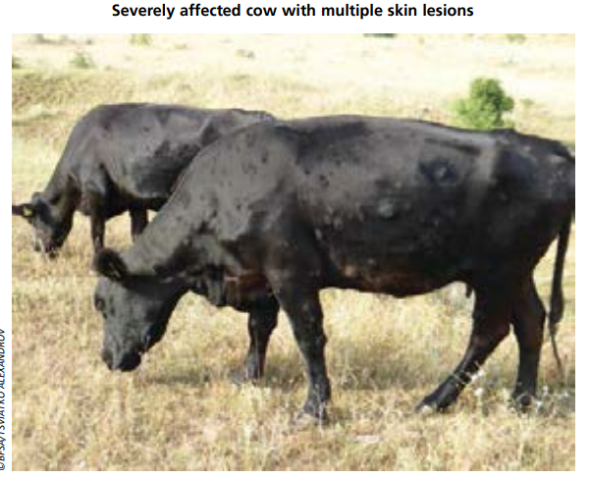
Different stages or severity levels of LSD
There are three stage in LSD according to the number of lesions visible:
No visible nodules - Normal
Less than or equal to 15 lesion nodules - mildly infected
More than 15 lesions nodules - severely infected

Slide 6
Scope & Limitations
Scope:
The development of a predictive model for cow Lumpy Skin Disease detection using deep learning to achieve accurate results will find scope in countries where the economy of the country depends cattle production, milk production etc.
Limitations:
-Classification cannot be 100% accurate.
-It only detects whether the animal has LSD, other diseases are not predicted.

Slide 7
Literature Survey
Title | Author | Description
Automatic segmentation and classification of skin lesions | Sumithra Ra, Mahamad Suhilb, and Guruc | They used SVM, KNN as well as fusion of both which yields around 46.71% and 34% of F-measure using logistic and KNN classifier respectively and with 61% of F-measure for fusion of SVM and KNN. Therefore, the performance of results is affected by the number of dataset and feature selection methods.
A Web-Based Skin Disease Diagnosis Using Convolutional Neural Networks. | Sam, Philip, Nartey, & Nti | They used TensorFlow framework for detecting skin diseases and CNN for feature extraction and web-based system to classifying and Diagnosis Atopic dermatitis, Acne vulgaris and Scabies.

Slide 8
Literature Survey
Title | Author | Description
 |  | The overall classification accuracy is 88%. However, the data size for the study is limited and the methods in this study are innovations of the traditional preprocessing method. Therefore Techniques to enhance the accuracy are not effective.
Cattle disease diagnosis by integrating image processing using deep learning with an expert system | Bezawit Lake | The classification model used convolutional neural network with three convolutiona.In the classification phase the trained model is used to classify the input images. Finally, the proposed approach scored 95 % accuracy. Generally, study was classified cattle skin disease into its three main classes (Ringworm and Wart).

Slide 9
Dataset
To maximize the number of images in the datasets, data augmentation is used to increase the dataset size and the area where Lumpy Skin Disease are present is cropped. With the help of veterinary Doctor, we divided the dataset into Severe Lumpy Skin Disease, Mild Lumpy Skin Disease and Normal Skin.
S.NO | Category | No of images | After augmentation
1. | Normal | 686 | 2145
2. | Mild | 110 | 1896
3. | Severe | 198 | 2004

Slide 10
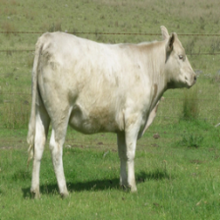
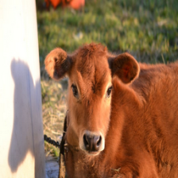
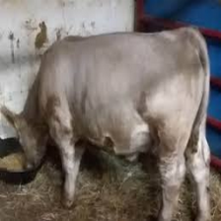
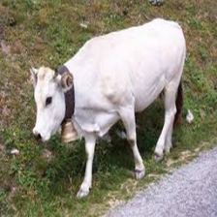
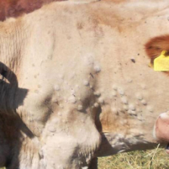
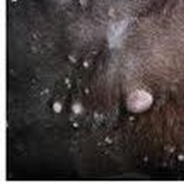
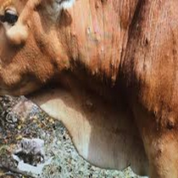
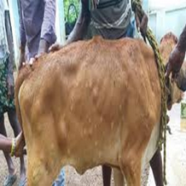
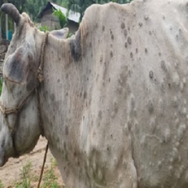
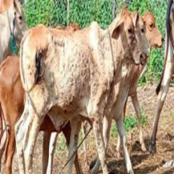
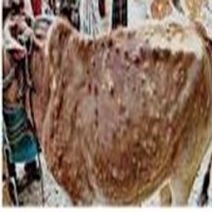
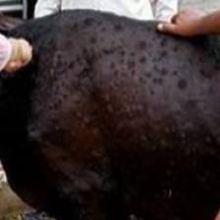
Preview of dataset
Normal
Normal
Normal
Normal
Mild
Mild
Mild
Mild
Severe
Severe
Severe
Severe

Slide 11
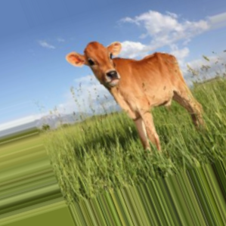
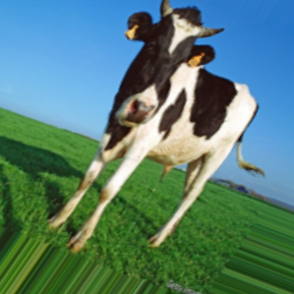
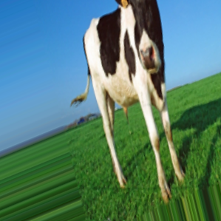
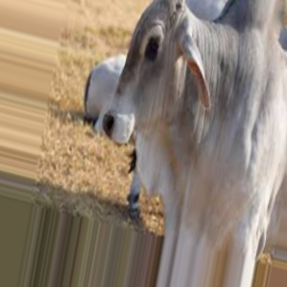
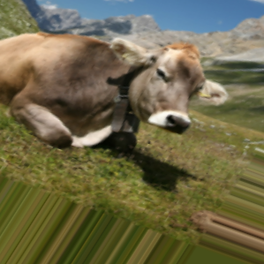
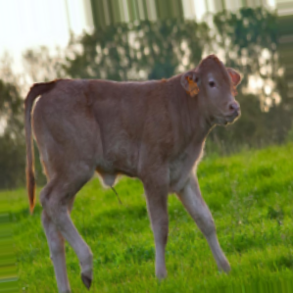
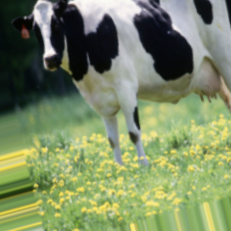
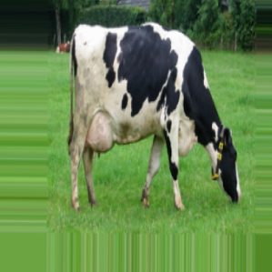
Preview of augmented dataset

Slide 12
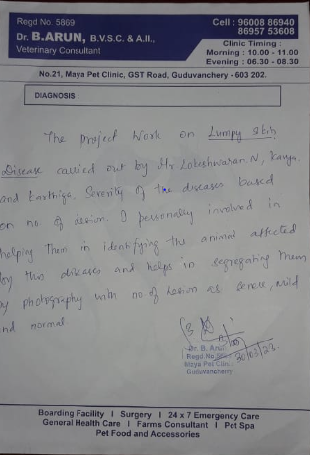

Slide 13
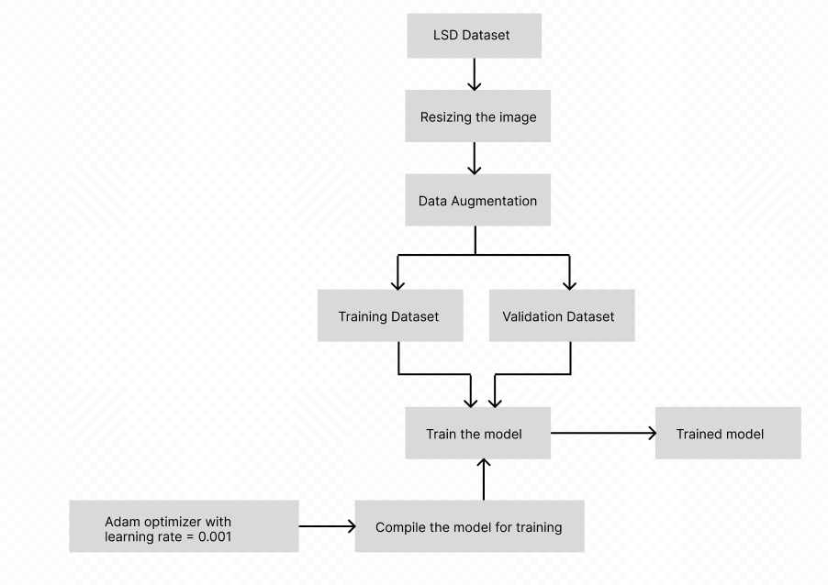
Proposed Methodology

Slide 14
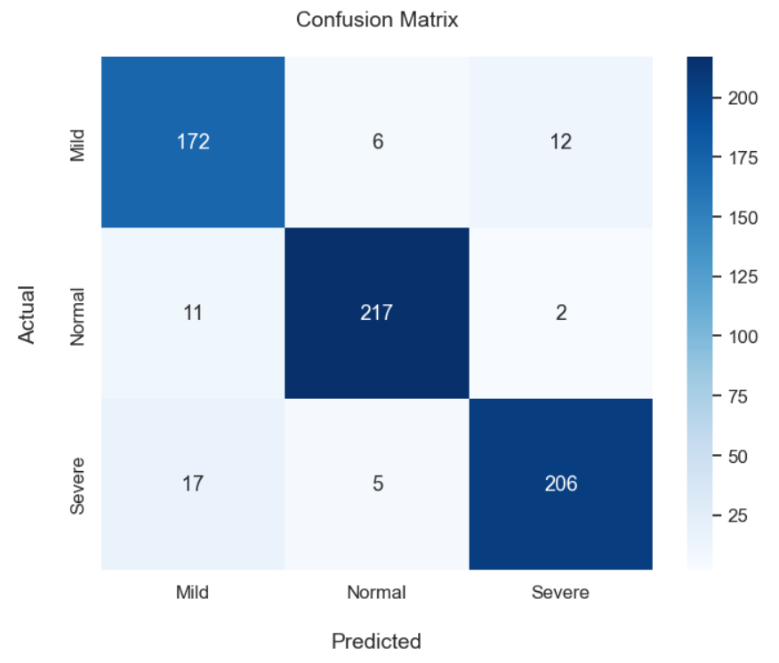
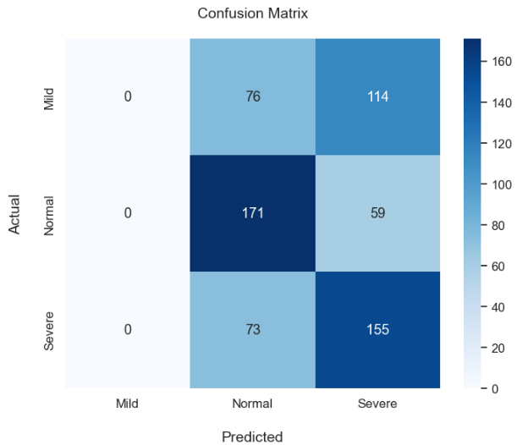
Confusion Matrix
MobileNetV2
ResNet50

Slide 15
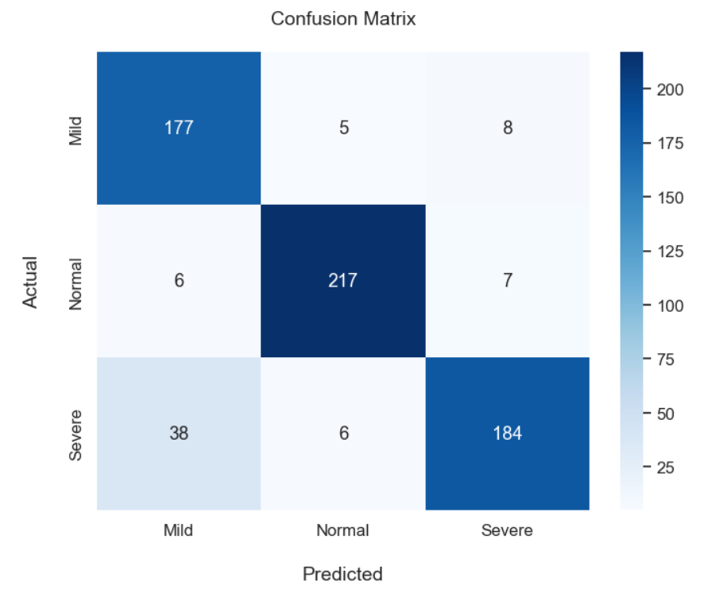
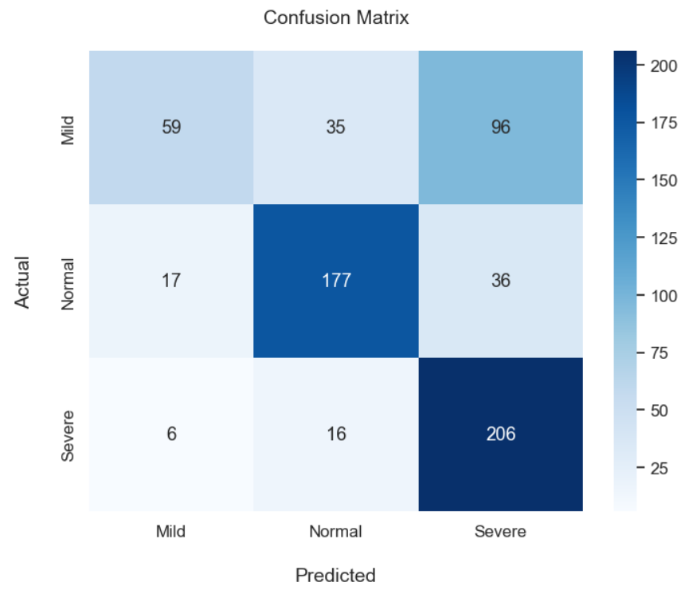
Confusion Matrix
VGG 19
Xception

Slide 16
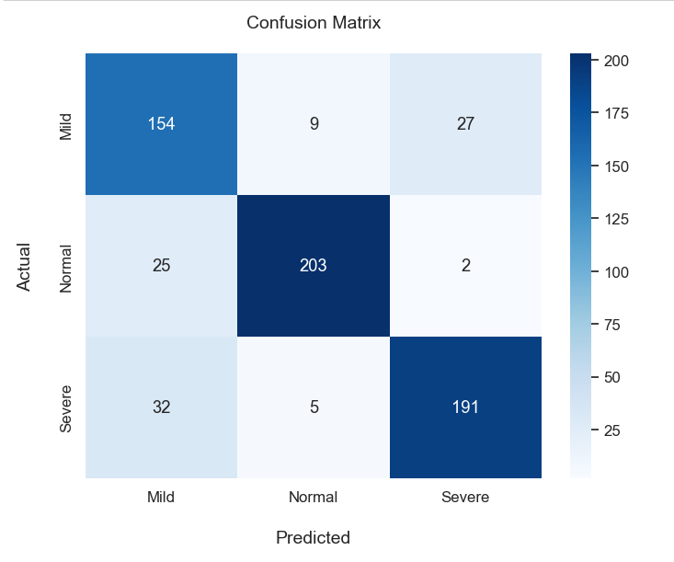
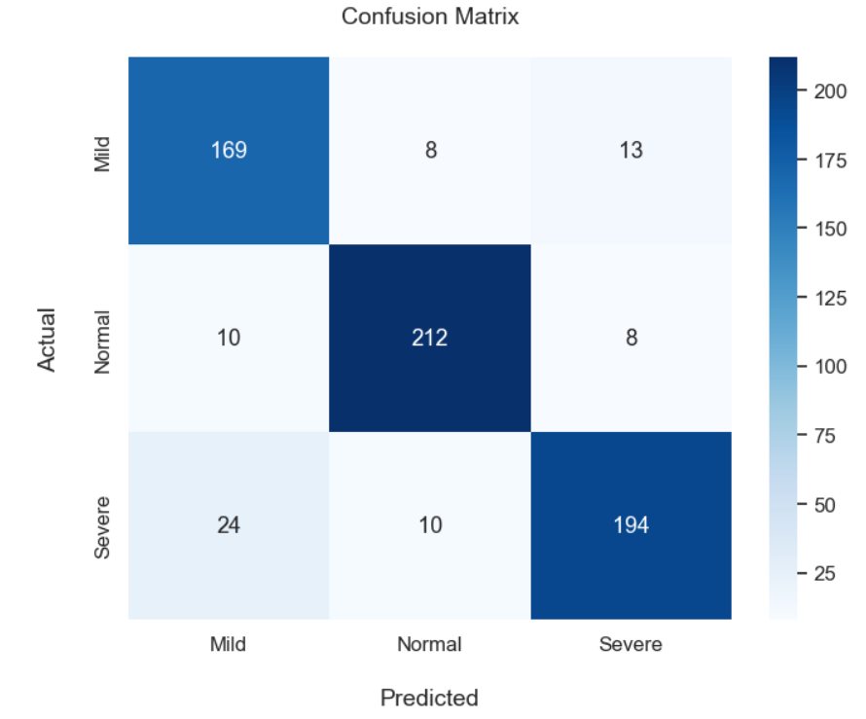
Confusion Matrix
DenseNet121
InceptionV3

Slide 17

Final Result
Automatically detects and classifies Lumpy Skin Disease using deep learning techniques.
Developed a classification models using different pre-trained deep learning models.
Compared the classification accuracy of different classification models.
The best model for our project is MobileNetV2.
Overall Accuracy: 91.82%

Slide 18
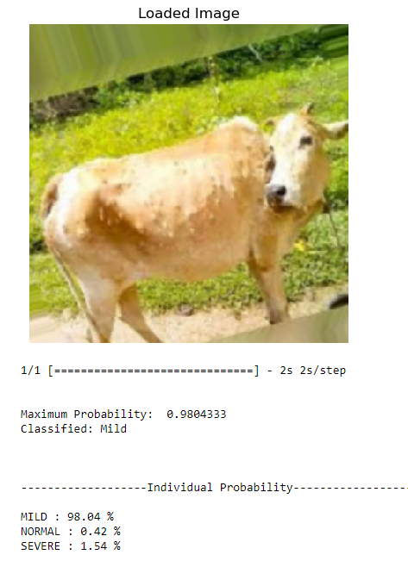
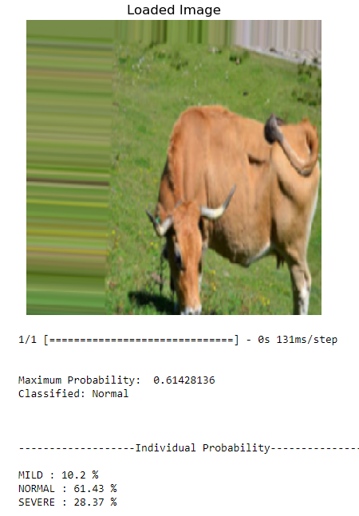
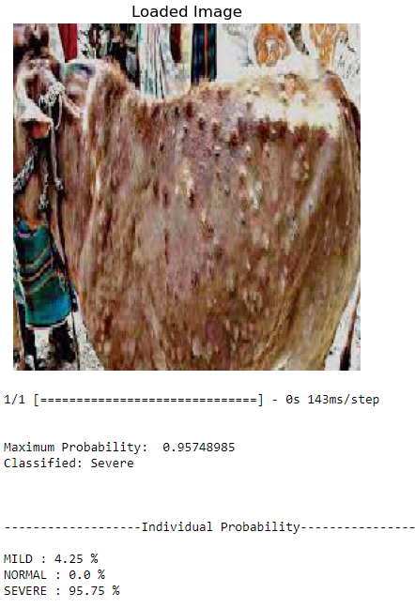
MOBILENETV2

Slide 19
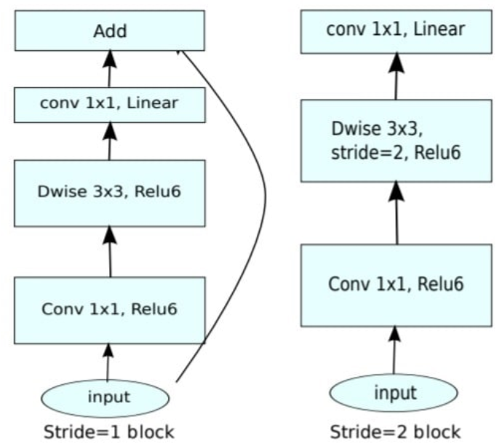
MOBILENET V2
There are two types of Convolution layers in MobileNet V2 architecture:
1x1 Convolution
3x3 Depthwise Convolution
Each block has 3 different layers:
1x1 Convolution with Relu6
Depthwise Convolution
1x1 Convolution without any linearity

Slide 20
Comparative Analysis Of Different Pre-Trained CNN Models Using Loss
Model | Training Loss | Validation Loss
DenseNet121 | 0.3273 | 0.7135
MobileNetV2 | 0.2320 | 0.7431
VGG19 | 0.3575 | 0.6919
Inception V3 | 0.3426 | 0.7465
Xception | 0.2683 | 0.7292
ResNet50 | 1.0335 | 0.3837

Slide 21
Overall performance statistics analysis for LSD Classifier
CNN Models | Kappa | Overall accuracy | PPV_Macro | PPV_Micro | TPR_Macro | TPR_Micro
DenseNet121 | 0.76836 | 0.8456 | 0.84451 | 0.84568 | 0.84362 | 0.84568
MobileNetV2 | 0.8770 | 0.9182 | 0.9160 | 0.9182 | 0.9174 | 0.9182
VGG19 | 0.5142 | 0.6820 | 0.7017 | 0.6821 | 0.6612 | 0.6821
Inception V3 | 0.82805 | 0.8873 | 0.88294 | 0.88576 | 0.88553 | 0.8857
Xception | 0.8380 | 0.8919 | 0.8924 | 0.8919 | 0.8940 | 0.8919
ResNet50 | 0.23153 | 0.50309 | None | 0.50309 | 0.47443 | 0.50309

Slide 22
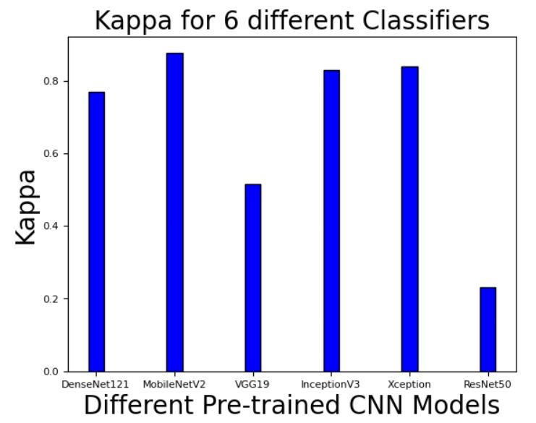
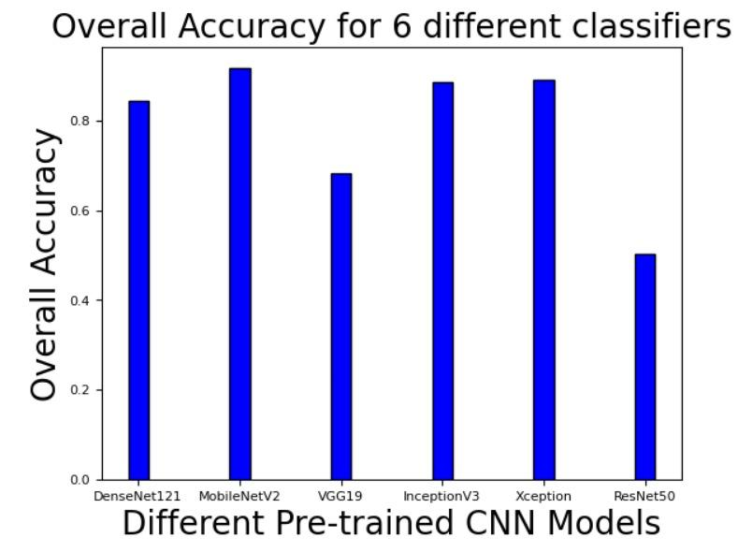
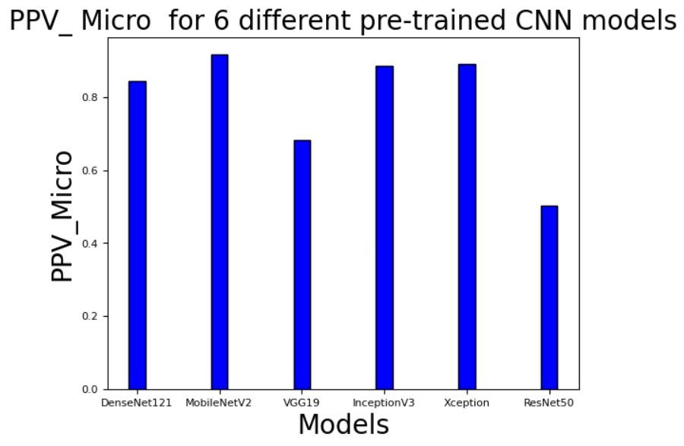
Overall performance statistics analysis using graphical representation

Slide 23
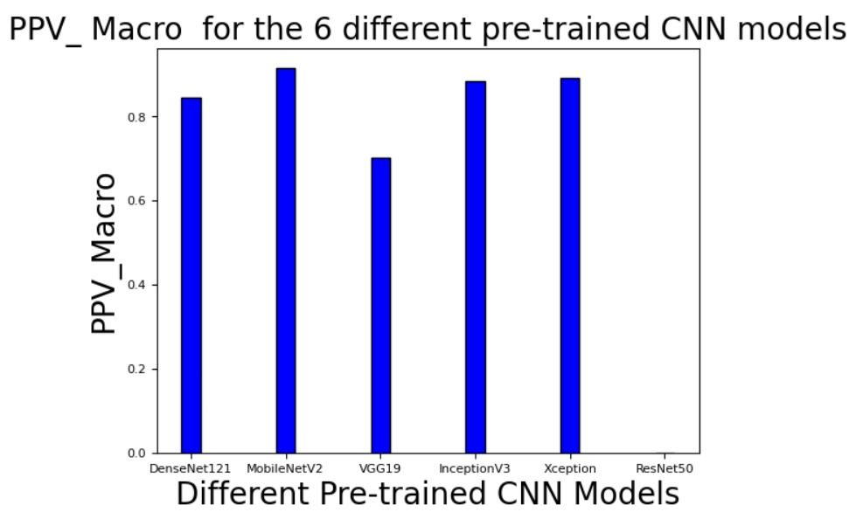
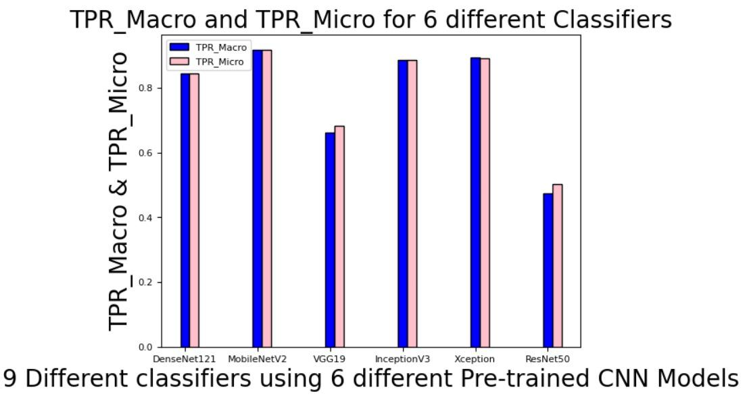
Overall performance statistics analysis using graphical representation

Slide 24
Individual performance statistics analysis of the pre-trained CNN models for mild class
CNN Models | Accuracy | F1 Score | F2 Score | Precision | Specificity | Sensitivity
DenseNet121 | 0.85648 | 0.76808 | 0.793 | 0.72986 | 0.87555 | 0.81053
MobileNetV2 | 0.92901 | 0.88205 | 0.89583 | 0.86 | 0.93886 | 0.90526
VGG19 | 0.76235 | 0.43382 | 0.35036 | 0.71951 | 0.94978 | 0.31053
Inception V3 | 0.91393 | 0.85333 | 0.87146 | 0.82474 | 0.92576 | 0.88398
Xception | 0.91204 | 0.8613 | 0.90214 | 0.8009 | 0.90393 | 0.93158
ResNet50 | 0.70679 | 0.0 | 0.0 | None | 1.0 | 0.0

Slide 25
Individual performance statistics analysis of the pre-trained CNN models for normal class
CNN Models | Accuracy | F1 Score | F2 Score | Precision | Specificity | Sensitivity
DenseNet121 | 0.93673 | 0.90828 | 0.8927 | 0.93548 | 0.96651 | 0.88261
MobileNetV2 | 0.96296 | 0.9476 | 0.94512 | 0.95175 | 0.9736 | 0.94348
VGG19 | 0.83951 | 0.77293 | 0.77091 | 0.77632 | 0.87799 | 0.76957
Inception V3 | 0.94366 | 0.92174 | 0.92174 | 0.92174 | 0.95599 | 0.92174
Xception | 0.96296 | 0.9476 | 0.94512 | 0.95175 | 0.97368 | 0.94348
ResNet50 | 0.67901 | 0.6218 | 0.6895 | 0.5343 | 0.6435 | 0.7434

Slide 26
Individual performance statistics analysis of the pre-trained CNN models for severe class
CNN Models | Accuracy | F1 Score | F2 Score | Precision | Specificity | Sensitivity
DenseNet121 | 0.89815 | 0.85268 | 0.84364 | 0.86818 | 0.93095 | 0.83772
MobileNetV2 | 0.94444 | 0.91964 | 0.90989 | 0.93636 | 0.96667 | 0.90351
VGG19 | 0.76235 | 0.72792 | 0.824 | 0.60947 | 0.68571 | 0.90351
Inception V3 | 0.91393 | 0.87585 | 0.86069 | 0.90233 | 0.94891 | 0.85088
Xception | 0.90895 | 0.86183 | 0.82808 | 0.92462 | 0.96429 | 0.80702
ResNet50 | 0.62037 | 0.5575 | 0.625 | 0.4725 | 0.5881 | 0.6798

Slide 27
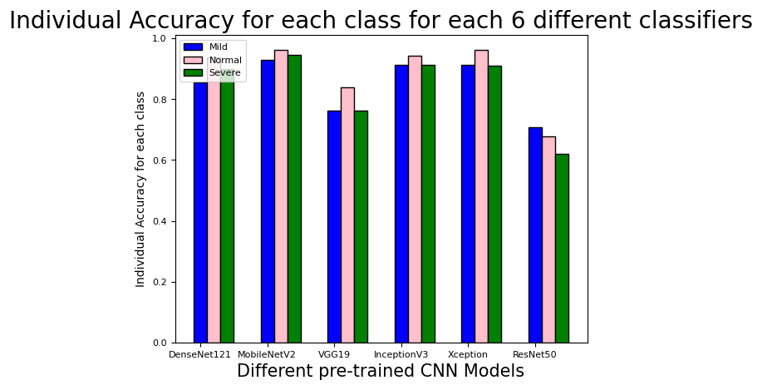
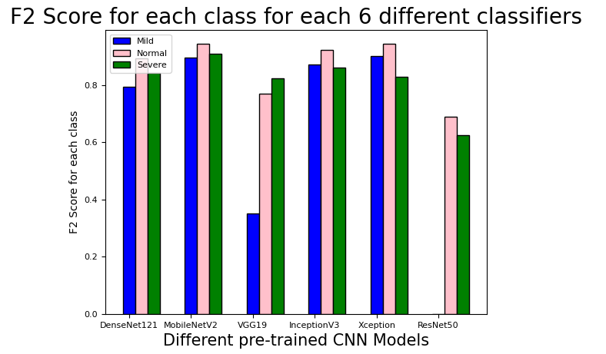
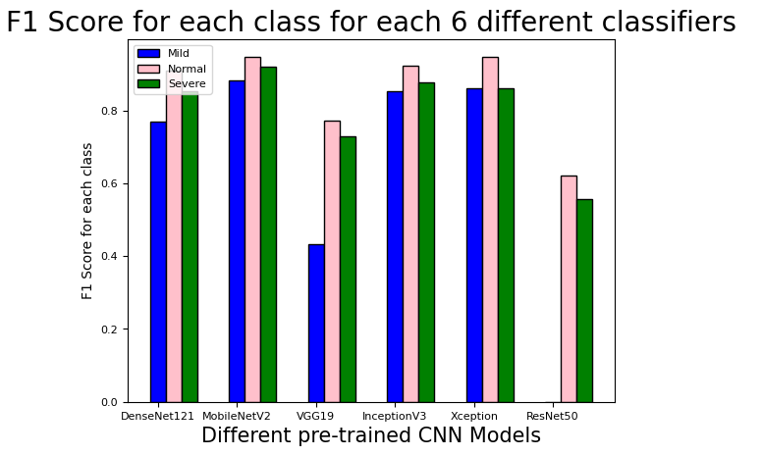
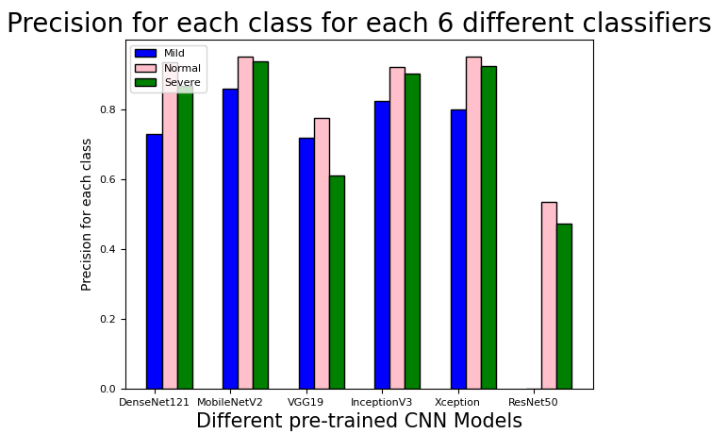
Individual performance statistics analysis in graphical representation

Slide 28
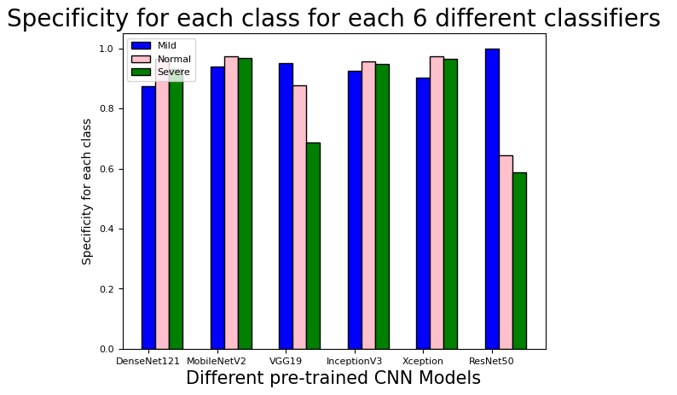
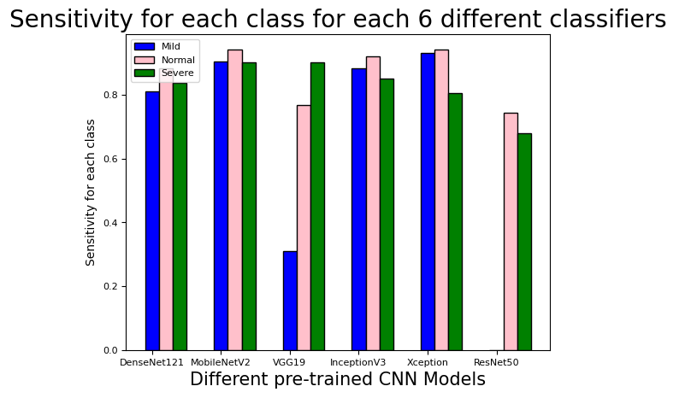
Individual performance statistics analysis in graphical representation

Slide 29
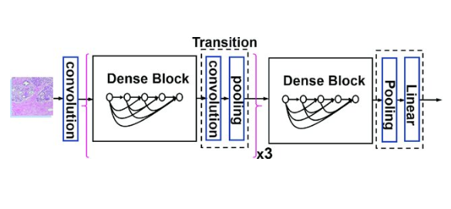
DENSENET 121
DenseNet-121 has the following layers:
1 7x7 Convolution
58 3x3 Convolution
61 1x1 Convolution
4 AvgPool
1 Fully Connected Layer

Slide 30

VGG19

Slide 31

INCEPTION V3

Slide 32

RESNET50

Slide 33
References
Eeva S.M. Tuppurainen, (2004), “The detection of lumpy skin disease virus in samples of experimentally infected cattle using different diagnostic techniques”, unpublished master thesis, Faculty of Veterinary Science, University of Pretoria
A.K. Singh , R.C. Upadhyay , D. Malakar , S.V. Singh , Suresh Kumar and Rajni Devi, (2001), “Role of Animal Skin in Thermoregulation”, Dairy Cattle Physiology Division, Animal Biotechnology Centre, National Dairy Research Institute, Karnal-132001 (Haryana) INDIA
Daniel Hailemichael, (2015), “Development of Automatic Maize Quality Assessment System Using Image Processing Techniques”, unpublished master thesis, College of Natural Sciences
"Vaccination to curb LSD epidemic of cattle", Dhakatribune. com, [online] Available: https://www.dhakatribune.com/bangladesh/nation/2020/01/11/vaccination-to-curb-lsd-epidemic-of-cattle?fbclid=IwAR38pW_kdDyi994rsXTC-B8Az88yVJyZviTsWD0a_BuJ-XFQzSDTw3G4L58.

Slide 34
THANK YOU!!

